Slide 1
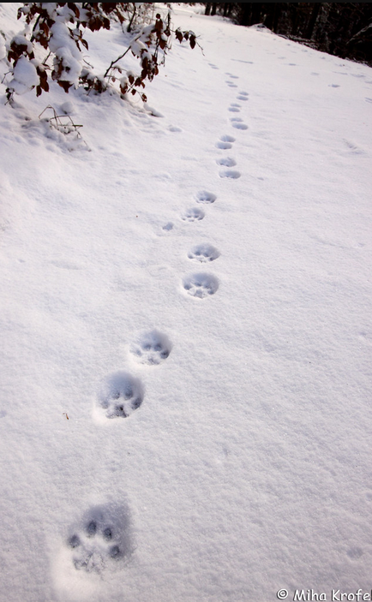
DINARIC LYNX REINTRODUCTION, REINFORCEMENT, MIGRATION
Nino Koci 4/24/2025

Slide 2
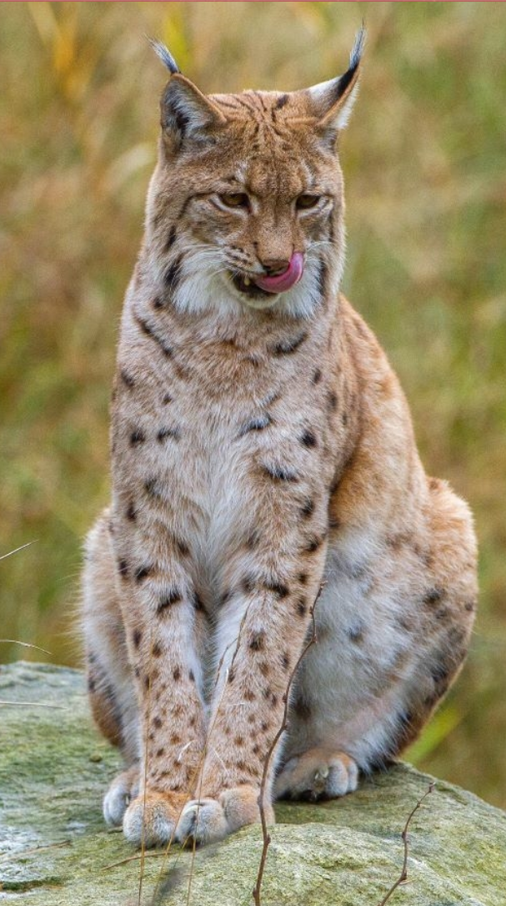
BACKGROUND
The Dinaric Lynx is a fine that was once present in the Balkans, particularly in Northern Yugoslavia(modern Croatia and Slovenia)
The population went extinct sometime in the beginning of the 20th century due to human activity and disturbance.
The population was then reintroduced in the region through a transplantation of 6 Carpathian lynx recruited from Slovakia.
After reintroduction, the lynx population grew rapidly and has claimed much of its former range.
However, the population now faces new challenges, namely, a noticeable loss of fitness stemming from high inbreeding.
Currently, there has been an effort to revitalize the population. Such as introducing ~12 new migrants from Slovakia and Romania to the Dinaric population between 2019 and 2023.

Slide 3
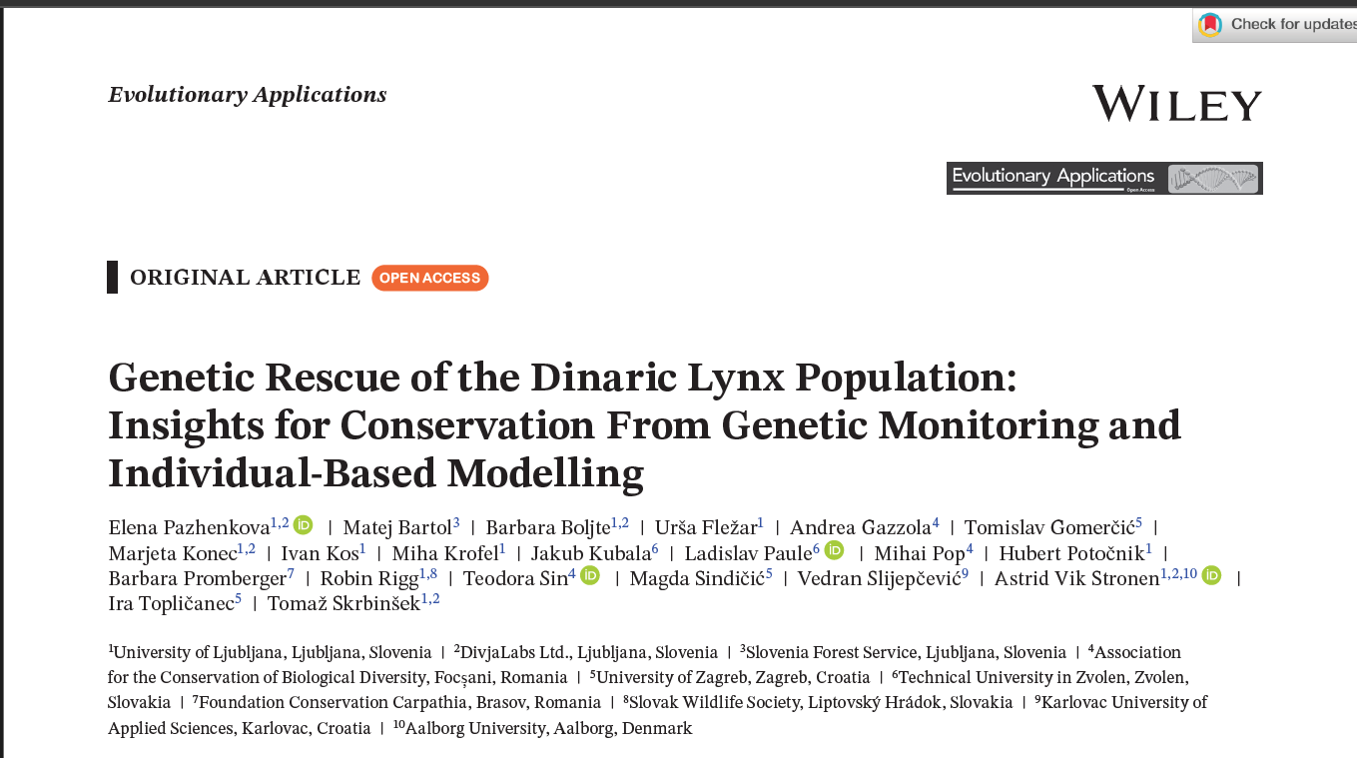
STUDY FROM PAZHENKOVA ET AL.
A study was recently conducted that assessed the fitness of the Dinaric Lynx based on 19 microsatellite markers in the Lynx Genome through sequencing non-invasive samples.
They focused on modeling the 1973 reintroduction of the species and measuring the effective population per generation and the effective inbreeding per generation
They found that the Dinaric population began displaying reduced nucleotide diversity and an increase in inbreeding after a rapid increase in isolation
Then they attempted to model the 2019-2023 population reinforcement by introducing new individuals from Slovakia and Romania during specific time intervals to effectively understand when to teach more genetic diversity to the Dinaric population.
Then, we modeled different population sizes for the new migrants and time intervals to determine how reinforcement affected population health.
Reinforcement throughout specific periods would have to become consistent for this maintenance.
Ultimately, the team seeks the best way to maintain the population’s health.

Slide 4

PURPOSE OF THE PROJECT
Based on the study by Pazhenkova et al., we will attempt to stimulate the reintroduction and reinforcement of the Dinaric Lynx.
We will use their methodology to set up the SLiM running parameters, alongside additional parameters derived from other sources such as Perez et al.
We will also explore an additional avenue of migration expansion between the different Lynx populations to challenge the reinforcement method.
We expect that the data will match Pazhenkova et al. and the migration model will yield positive results

Slide 5
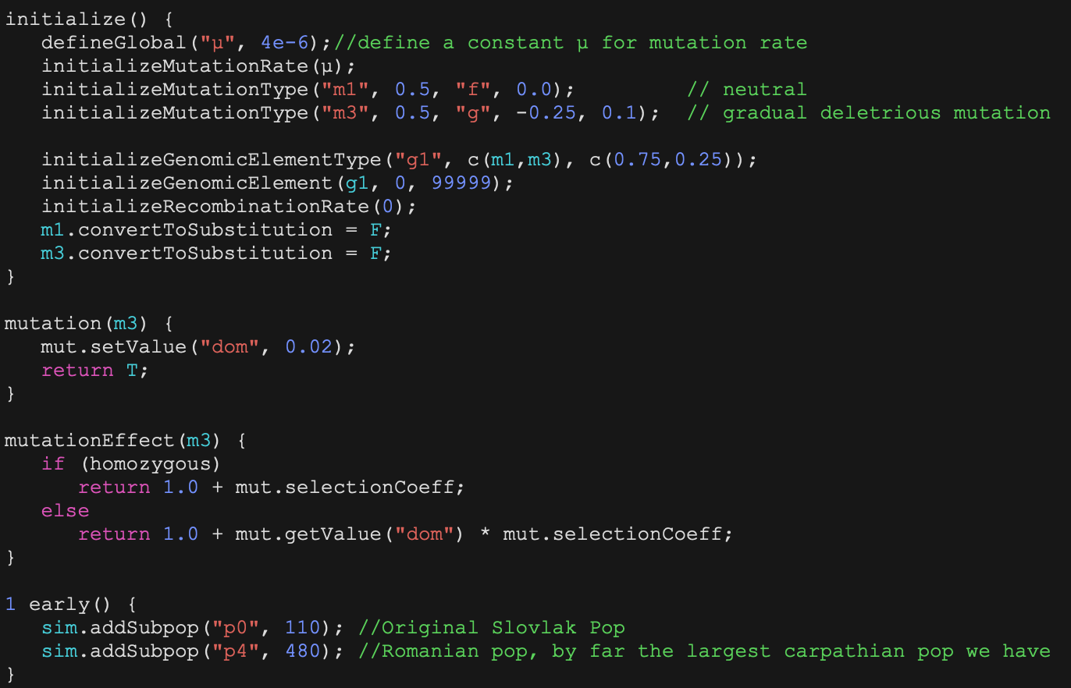
PART 1: REINTRODUCTION
The initial run will focus on recapturing Figure 3 in Pazhenkova et al.
We will introduce two mutations
One neutral, half-dominant mutation that occupies ¾ of the genome.
One Gaussian mutation is mildly deleterious in homozygotes with a low standard deviation.
The mutation rate(μ) will be estimated via the general nucleotide diversity (π) value of the population from Perez et al. and the average census size(N) from Pazhenkova et al.
We assume around 50 ticks to introduce the mutations and allow some gene flow to occur before reintroduction.
The average nucleotide diversity is around 3.5e-4, and the average N is around 28.
It comes around 3.1e-4, but we changed it to 4e-6 as it returned more faithful values.
We will focus on modeling the original Slovak population over a few generations
We will also allow gene flow between it and the Romanian population, with migration rates based mainly on population size and distances.
Both population sizes will use an estimated N.

Slide 6
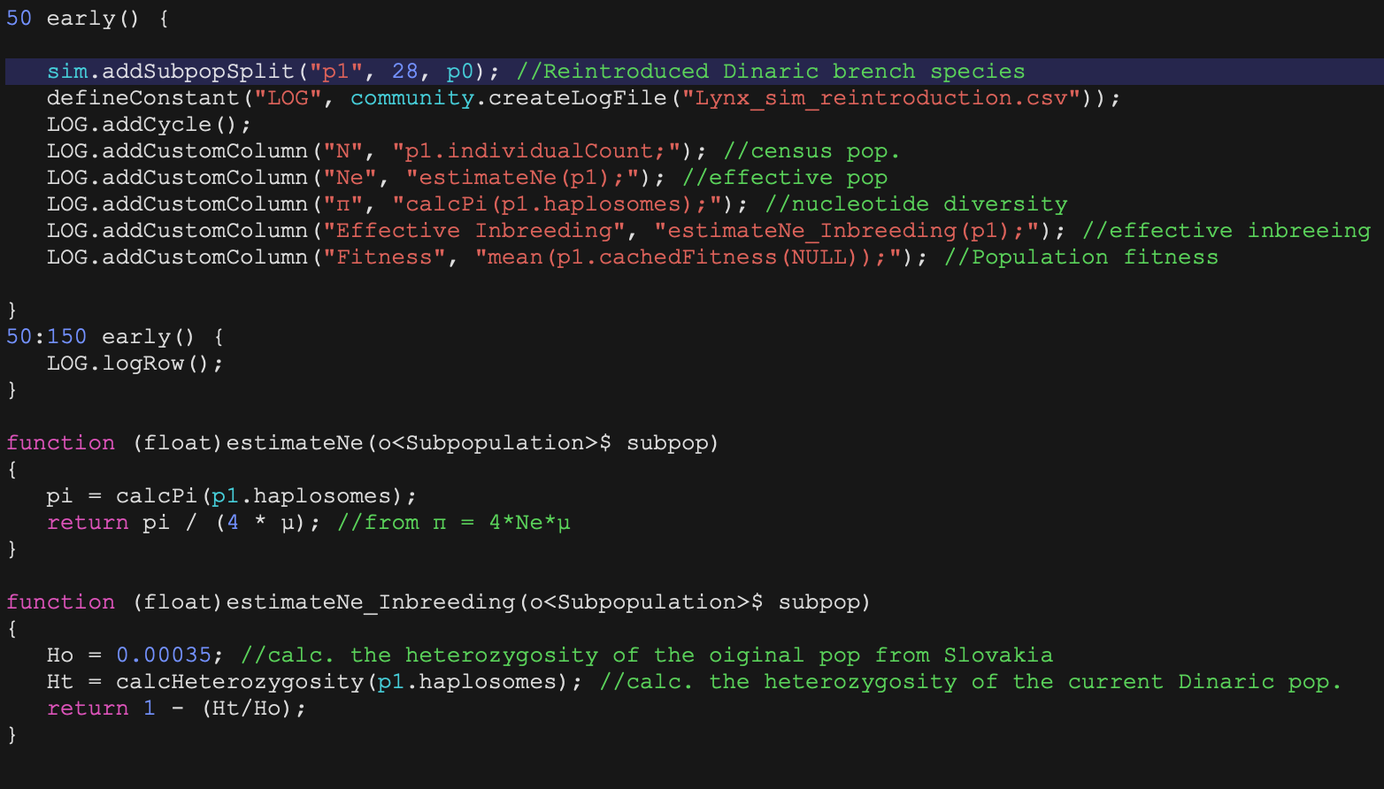
PART 1: REINTRODUCTION(CONT.)
Then we add a bottleneck-like event to stimulate the reintroduction
The bottleneck will jump to the population recovering and reaching its census size.
We will measure the effective population(Ne) and the effective inbreeding(Fe) of the reintroduced population
Ne will be calculated as π/4*μ:
π will be calculated via the built-in function calcPi(p.haplosomes)
Fe will be calculated via the equation 1- Ht/Ho:
Ht, or the current heterozygosity, will be calculated via the function calcHeterozygosity(p.haplosomes).
Ho is the original heterozygosity of the population, and we will use the population’s general π value(3.5e-4). As we assume in this case that heterozygosity ≈ π.
The ticks for this simulation will be based on time in years, as in Pazhenkova et al.
So one tick, one year.
So we will stimulate the original population for 50 years, perform the bottleneck, and then run the initial reintroduction for 50 years.
50 years roughly corresponds to a time frame from 1970 to 2020.
However, we will run the simulation for an additional 50 ticks so that we may also emulate the results for figures 4a and 4b in Pazhenkova et al.

Slide 7
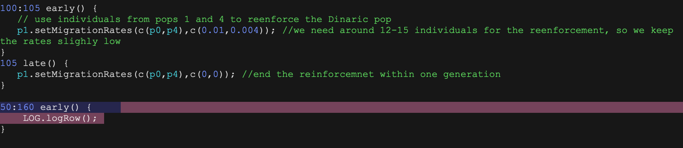
PART 2: REINFORCEMENTS
In this portion of the code, we will reinforce the inbred population by reintroducing new individuals to recreate Figure 4 from Pazhenkova et al.
Then we will create a small migration event that will introduce around 15 new individuals from the Romanian and Slovak populations combined.
We will keep their mutual gene flow from the last run.
However, we will add a migration pattern from tick 100 to tick 105 to reintroduce the individuals, roughly emulating the time from 2019 to 2023.
We set the migration patterns to zero after a tick of 105.
The simulation will then run for an additional 60 ticks to simulate the time from 1970 to 2080.

Slide 8
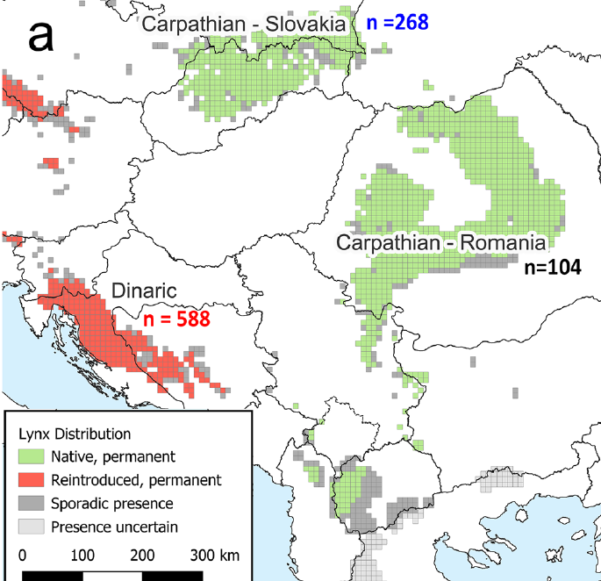
PART 3: MIGRATION
Unlike in Part 2, we will focus on a broader genetic rescue project.
Assuming reinforcement is unsuccessful, perhaps a better way is to reconnect lynx populations across the Balkan peninsula.
This means getting the population from the Dinaric mountains in Croatia and Slovenia to migrate and exchange genes with their neighbors in Albania, Kosovo, Macedonia, and Serbia.
In addition, we can allow the Romanian and Slovak populations in this gene flow by using the Serbian population as a proxy
We will set migration populations and rates based on distance and the likelihood of these populations interacting with each other.
Figure 1a from Pazhenkova et al. is roughly a blueprint for the migration model.
We will run a similar time scale as in part 2 and observe the differences.

Slide 9
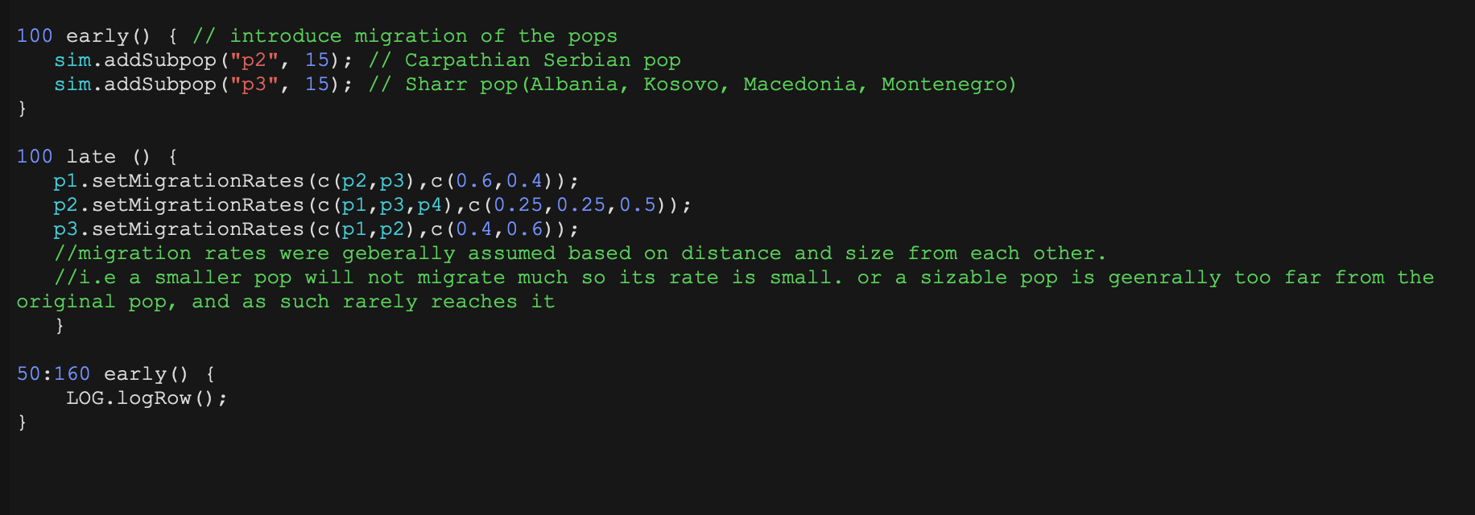
Migration Code

Slide 10
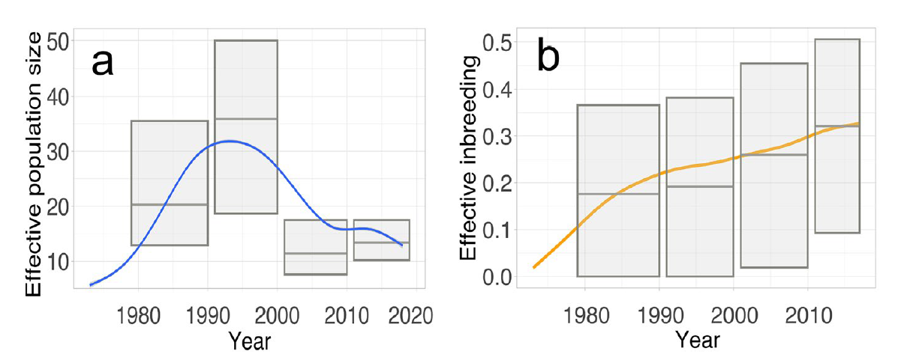
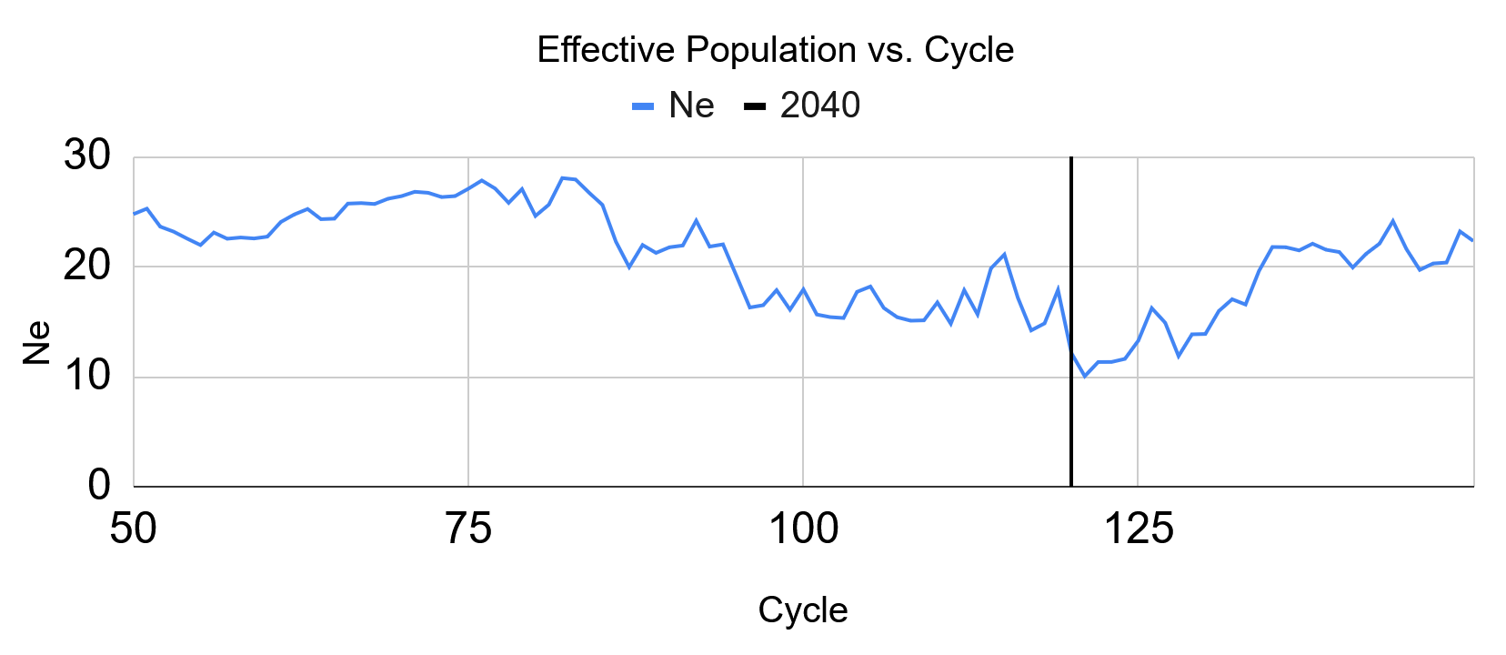
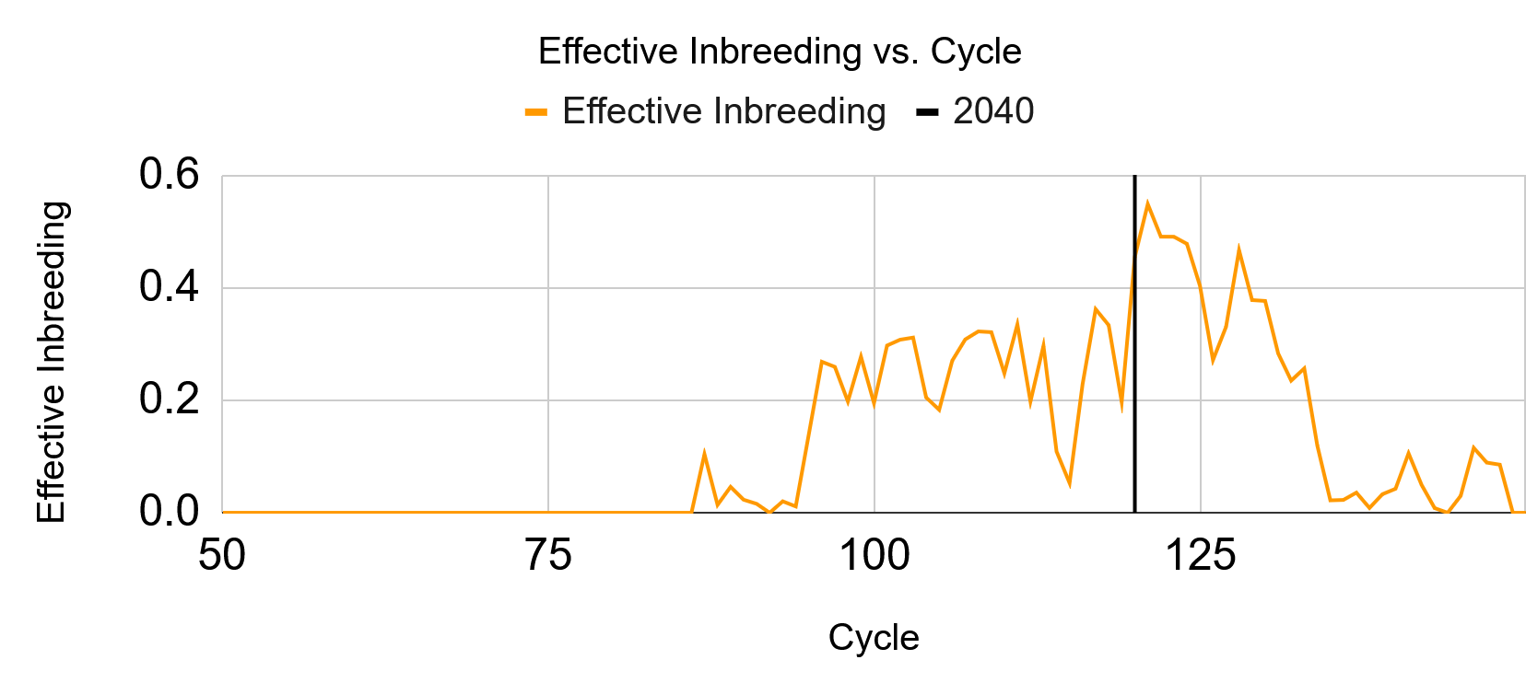
RESULTS FROM REINTRODUCTION
In both the Ne graph, we see that the we reach a peak at around 25 years/ticks after starting and then we experience a gradual decline.
However, we see that inbreeding only begins to ramp up in the SLiM simulation around 30 years after beginning the simulation, but still reaches values as in the article’s results.

Slide 11
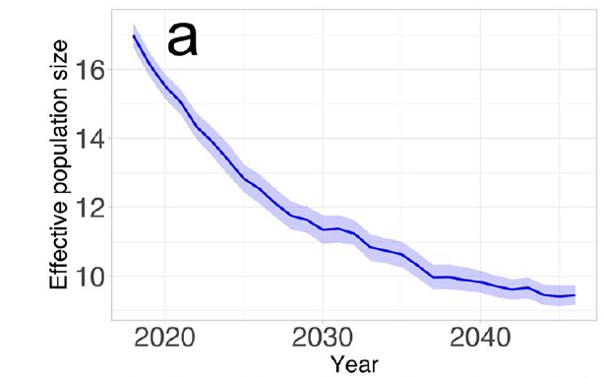
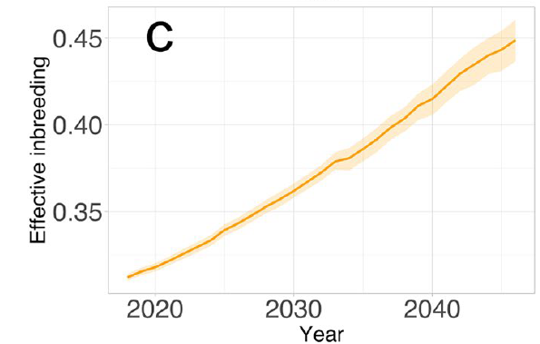
RESULTS FROM REINTRODUCTION(CONT.)
By comparing the results of Figure 4a and 4c with the rest of the reintroduction results, we notice that our results after 50 years/ticks have similar values.
However, there appears to be a significant difference post 70 ticks in SLiM, in that we notice the inbreeding reduces and the effective population rises. This could be an error from the simulation or a purge killing the inbred members of the population.

Slide 12
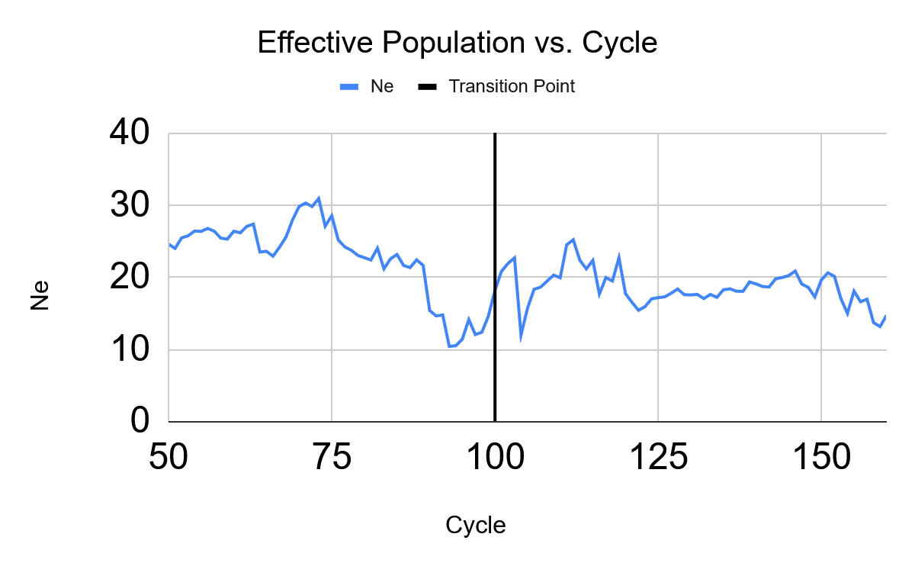
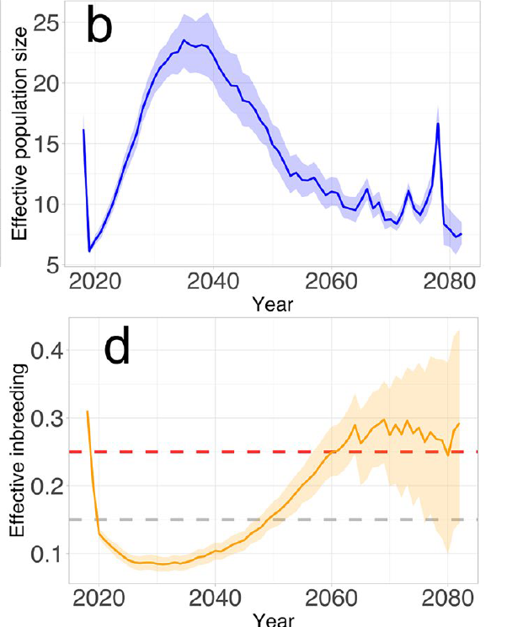
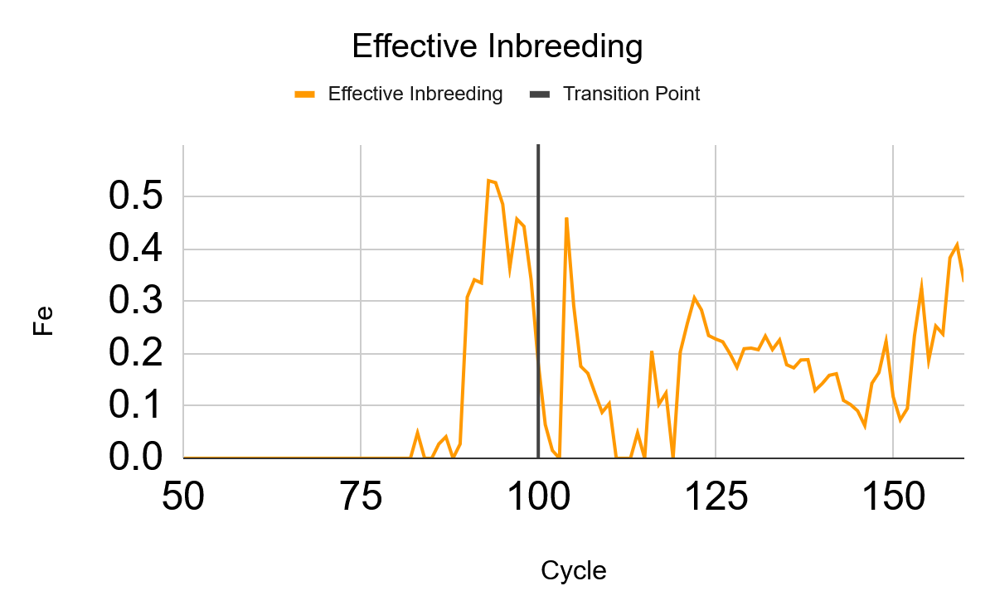
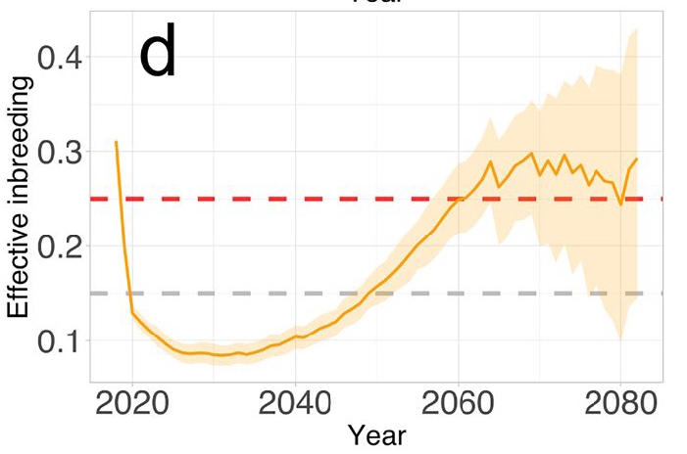
RESULTS FROM REINFORCEMENT
Based on the results from the SLiM simulation and figures 4b and 4d from Pazhenkova et al., we see that the results appear somewhat similar. With SLiM having a bit of a delay.
The only significant distinction between the two is that the population between 2040 and 2080 in the SLiM model appears to show signs of recovery before climbing back up. This could be from a potential purge or sweep occurring in the simulation.

Slide 13
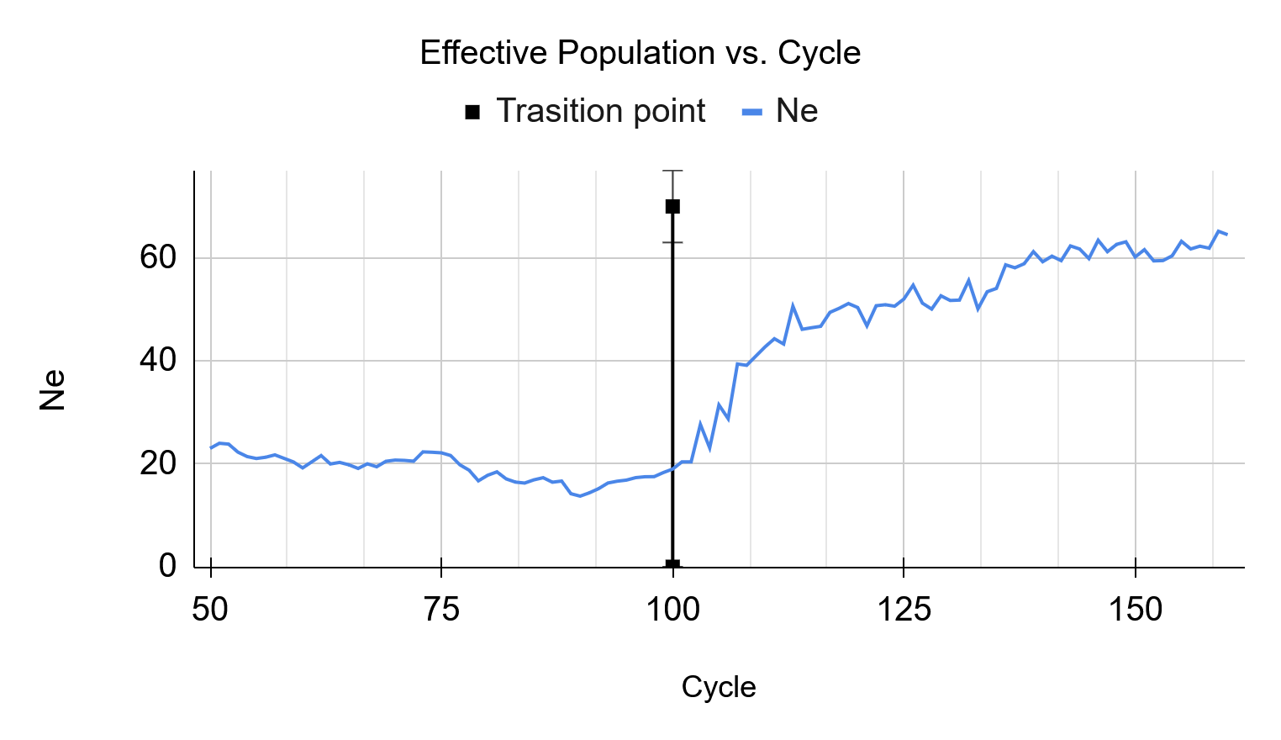
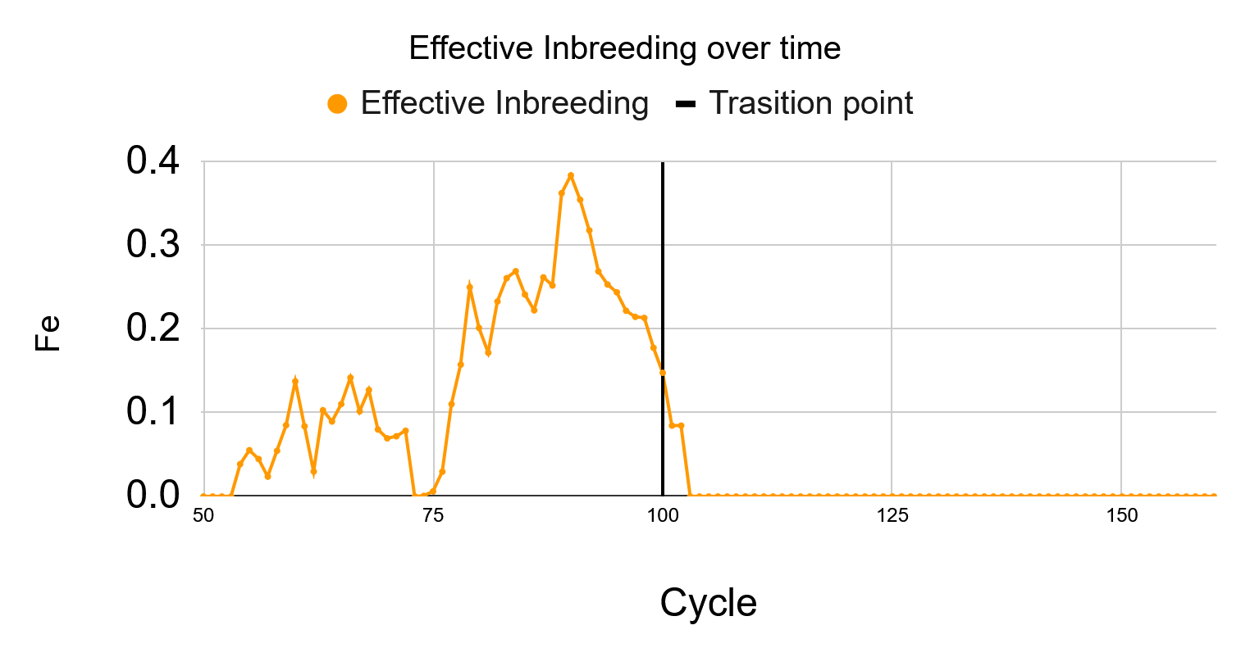
RESULTS FROM MIGRATION
In the case of migration, we see that the population does resemble our two previous runs. However, the Ne value seems to grow after tick 100, until reaching a plateau of around 60.
Similarly, the effective inbreeding climbs up only to decrease significantly when migrations occur after tick 100.
In both graphs, it is apparent that migration has offered a much more effective way of reducing inbreeding in the population as compared to reinforcement.

Slide 14
POTENTIAL IMPROVEMENTS AND EXPANSIONS
We could include a progressive population growth within the model better to capture the founder effect of the six founder lynx.
Reproduce the study from Pazhenkova et al. using microsatellites. This will give us a better overview of the genomic component of the model, which we can incorporate into our SLiM model.
Identify the deleterious mutations and behaviors that cause the loss of genetic diversity within the population.
Perform thorough parameter fitting to ensure we have more realistic parameters of the lynx population while maintaining reproducibility within different iterations of the SLiM model.

Slide 15
QUESTIONS?
Thank you!!!

Slide 16
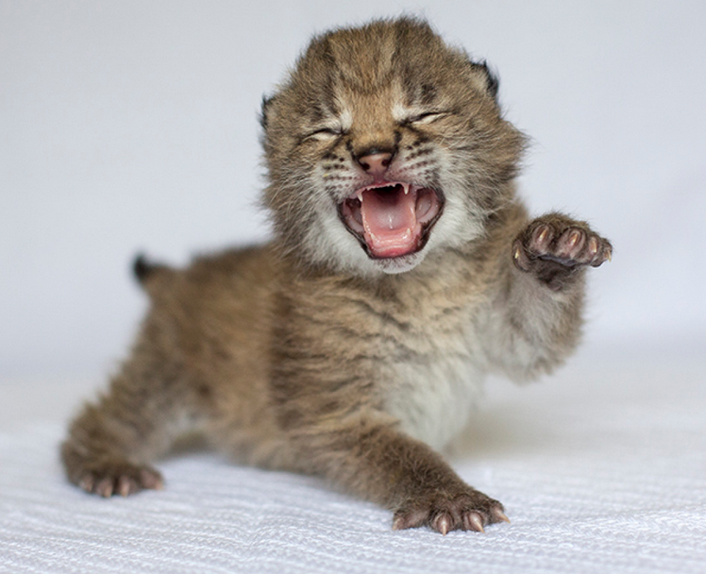
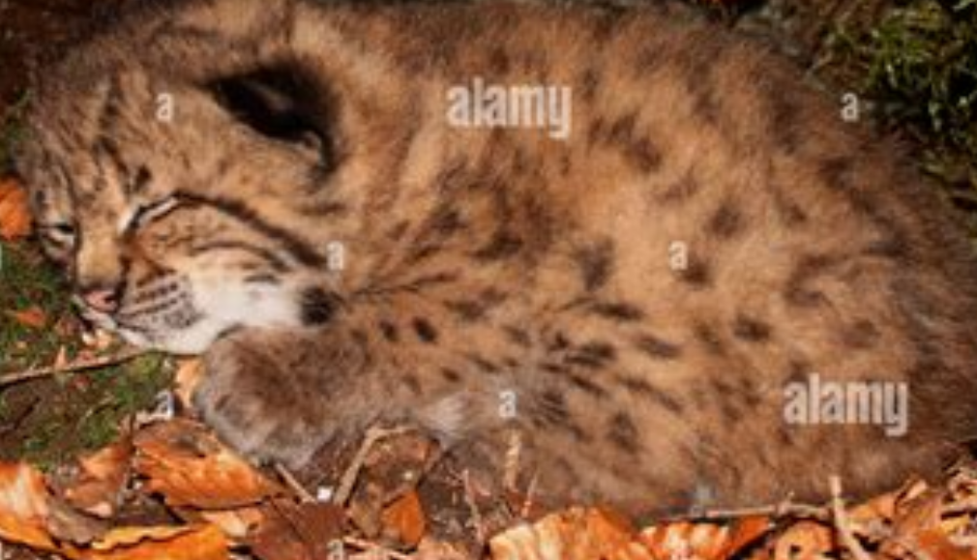
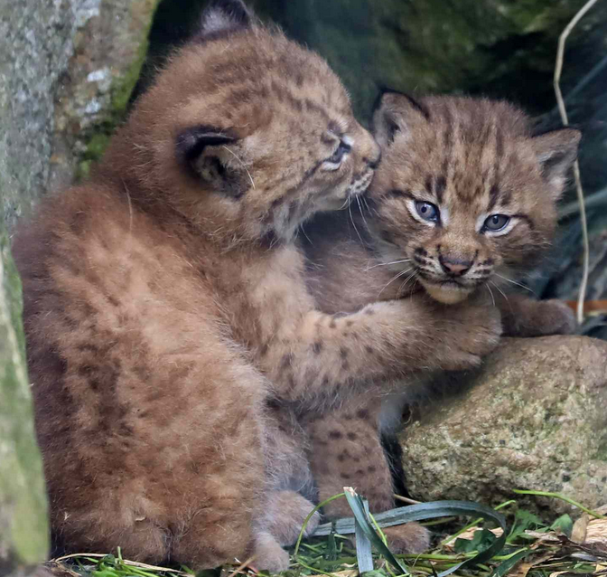

Slide 17
EXTRA SLIDES

Slide 18
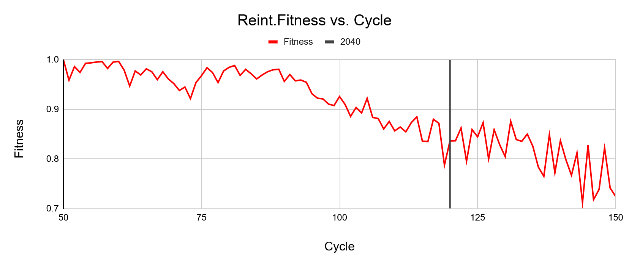
FITNESS OF THE REINTRODUCTION

Slide 19
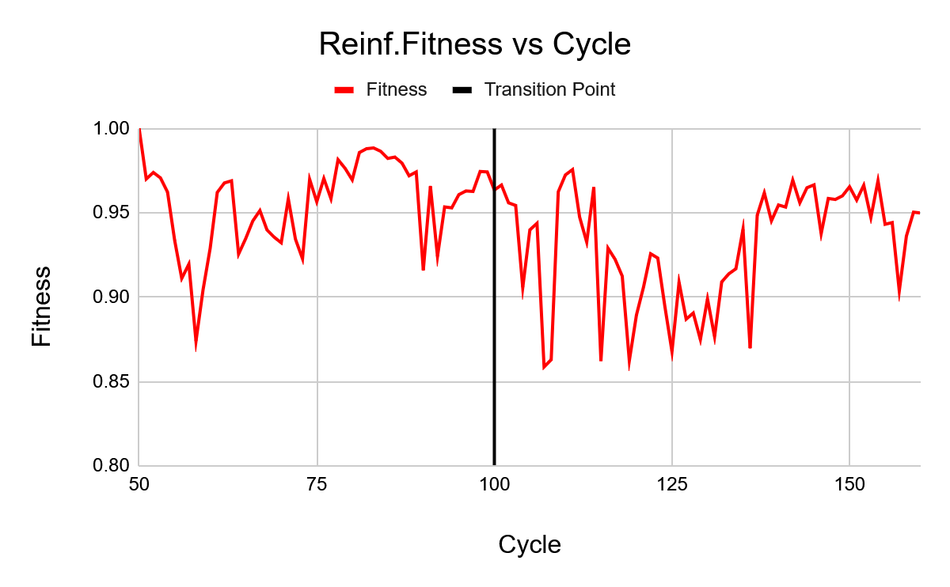
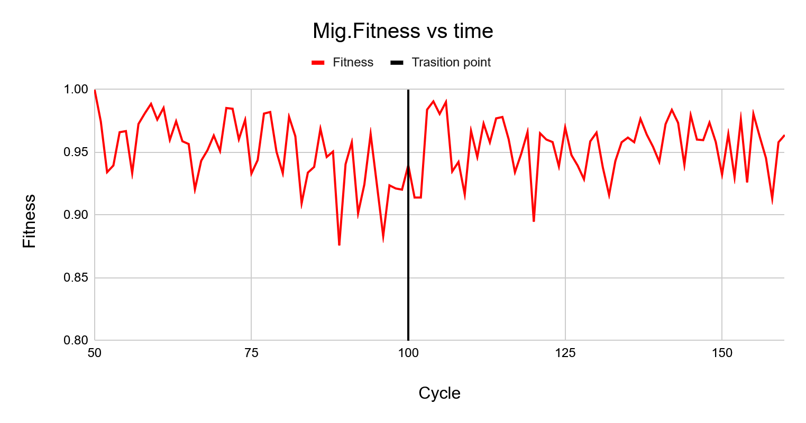
FITNESS COMPARISON: REINFORCEMENT VS MIGRATION

